Slide 2


Slide 3


Slide 4


X

Slide 5


Normal Distribution
Understanding a Fundamental Distribution
X

Slide 6
Normal Distribution
We’ve already explored PMFs and PDFs as well as some data distributions.
However we have yet to explore one of the most frequently used and fundamental distributions: the normal distribution.
X

Slide 7
Normal Distribution
Let’s explore the types of problems we’ll be able to answer once we understand the normal distribution and identify real-world data distributions that follow a normal distribution.
X

Slide 8
Normal Distribution
If you are working with a dataset that you can treat as normally distributed you have unlocked another set of tools (equations) you can use to calculate probabilities of outcomes.
X

Slide 9
Normal Distribution
One of the key tools used in normal distributions is a Z-Score.
Fundamentally, once you are able to treat a real world data set as normally distributed, you will be able to calculate the probability of data points being between any interval range.
X

Slide 10
Normal Distribution
For example, imagine you run a hospital and collect data around length of human pregnancies in days. Once you have the mean and standard deviation of the data set and have tested that it’s following a normal distribution, you can calculate the probability of a pregnancy lasting longer than N days.
X

Slide 11
Normal Distribution
You could imagine that calculating probabilities like this can help aid in all sorts of tasks, such as scheduling hospital staffing, managing inventory for deliveries, or alert systems for pregnancies lasting longer than N days. The key idea to keep in mind is that the answers would still be in probability terms!
X

Slide 12
Normal Distribution
Normal Distribution Section Topics:
Mean, Variance, Standard Deviation
Normal Distribution Overview
Standard Normal Distribution
Z-Scores
X

Slide 13
Normal Distribution
The normal distribution is one of the most common distributions we use in business because so many real-life data sets end up resembling a normal distribution.
X

Slide 14

Normal Distribution
Formally, the normal distribution is defined as a type of continuous probability distribution for a real-valued random variable.
The general form of its probability density function is:
X

Slide 15
Normal Distribution
While the formula can be a bit complex at first sight, take a close look at the terms, you only need the mean and standard deviation!
The general form of its probability density function is:
X

Slide 16
Normal Distribution
Let’s take a step back and think about the shape of a normal distribution and what that implies for people who want to use its properties to answer questions.
X

Slide 17
Normal Distribution
Fundamentally we can think of the normal distribution as a data distribution where most values tend to fall closer to a mean value and are distributed with some degree of variance.
For example, heights of people are normally distributed. Most people are close to the average height, then less people are very short or very tall.
X

Slide 18
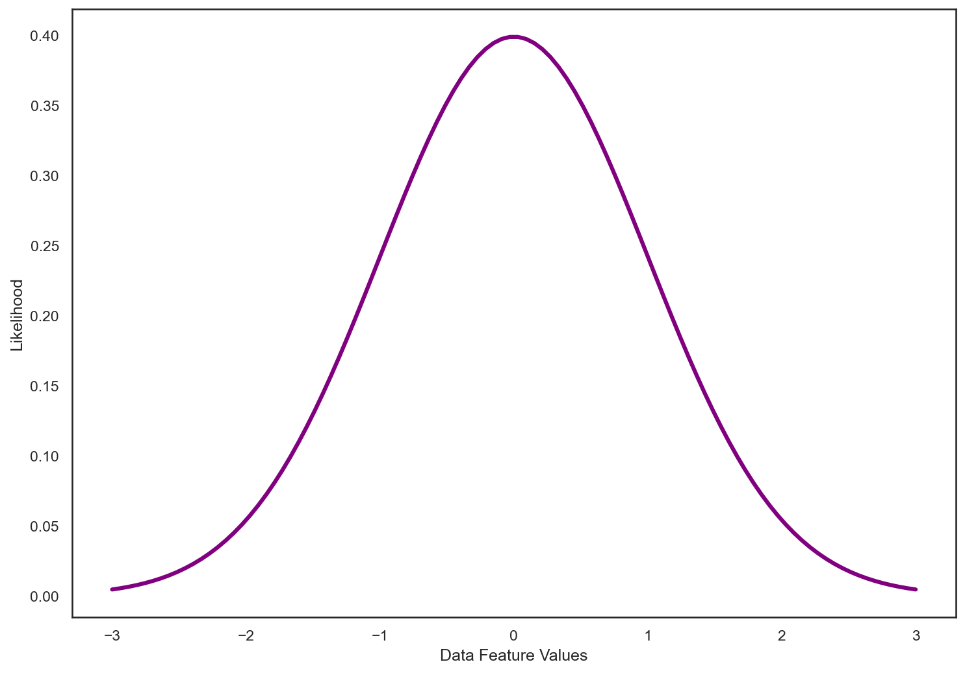
Normal Distribution
You’ll often see a visualization of a normal distribution look something like this:
X

Slide 19
Normal Distribution
Notice how its a PDF showing the likelihood of choosing a particular data feature value.
X

Slide 20
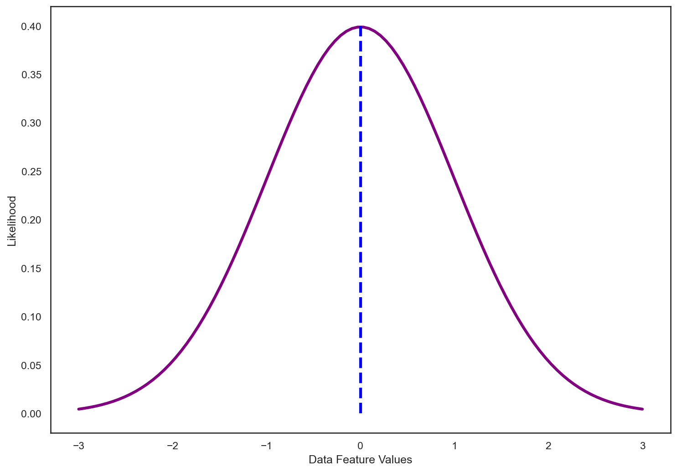
Normal Distribution
In this case we see it is centered around a mean value of zero.
X

Slide 21
Normal Distribution
However, a normal distribution can have any mean value…
X

Slide 22
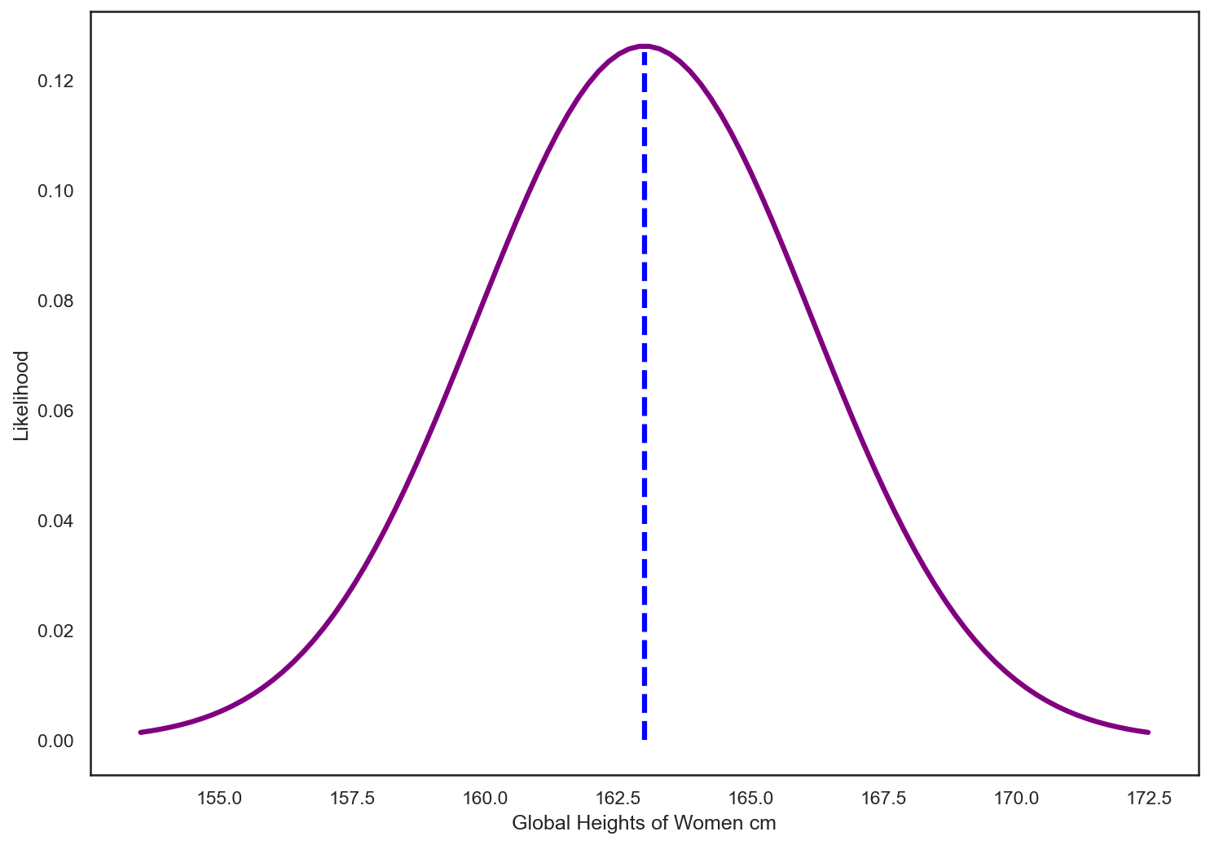
Normal Distribution
Here we see a normal distribution for global heights of women, with a mean of 163cm.
X

Slide 23
Normal Distribution
We’ve also seen the normal distribution is defined by the standard deviation.
X

Slide 24
Normal Distribution
Imagine a dataset with a wider variance, such as the prices used cars are sold at.
Depending on the condition of the car, we could have a wide range of possible prices being paid for used vehicles.
Thus a larger standard deviation value!
X

Slide 25
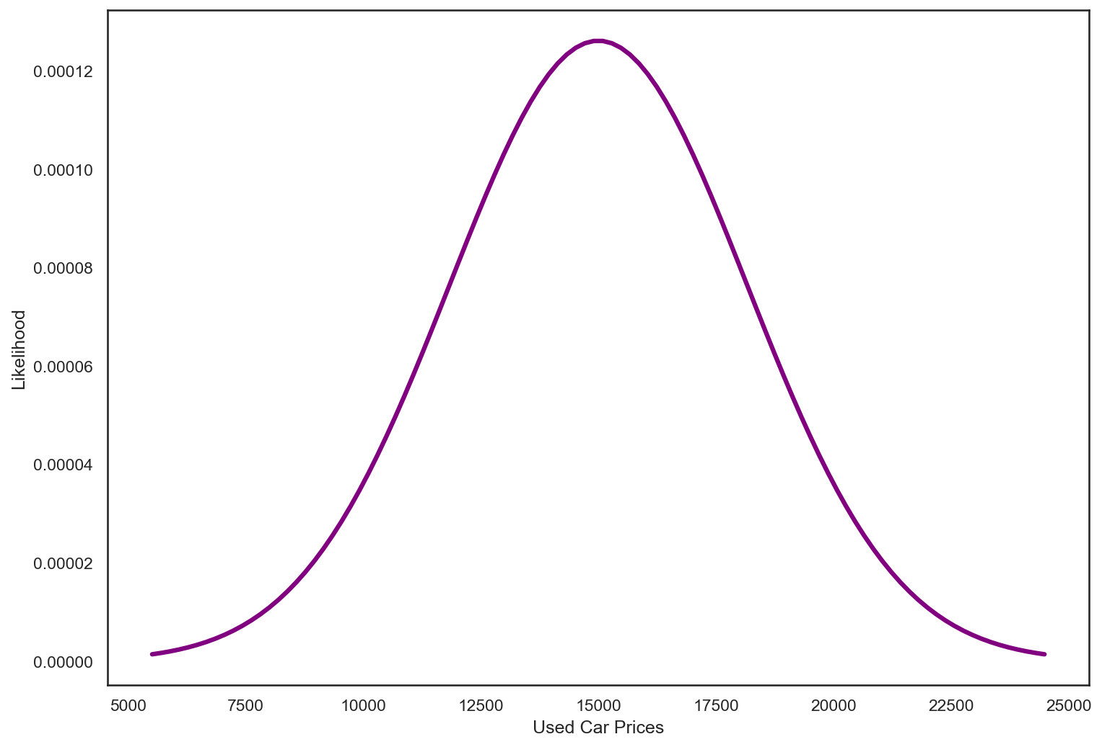
Normal Distribution
Normal distribution of used car prices:
X

Slide 26
Normal Distribution
Notice how wide the range is however…
X

Slide 27
Normal Distribution
So you are now probably wondering:
How does this work in real life?
Remember in “real life” we won’t have nice PDF curves to start out with, instead we have a series of values, such as a dataset of used car prices or measurements of heights.
X

Slide 28
Normal Distribution
Imagine we’re in charge of a school and are performing standardized testing.
Perhaps we’re trying to analyze the probabilities of students across the nation scoring particularly well on the test.
Can we use our single school as a sample of the overall student population?
X

Slide 29
Normal Distribution
Imagine you have the dataset for student test scores for our school:
Student ID | Test Score
1 | 70
2 | 85
… | …
99 | 30
100 | 94
X

Slide 30
Normal Distribution
Imagine you have the dataset for student test scores for our school:
Student ID | Test Score
1 | 70
2 | 85
… | …
99 | 30
100 | 94
X

Slide 31
Normal Distribution
We now need to test if this data is normally distributed. There are few ways to do this, a simple way is to just visualize the data.
Student ID | Test Score
1 | 70
2 | 85
… | …
99 | 30
100 | 94
X

Slide 32
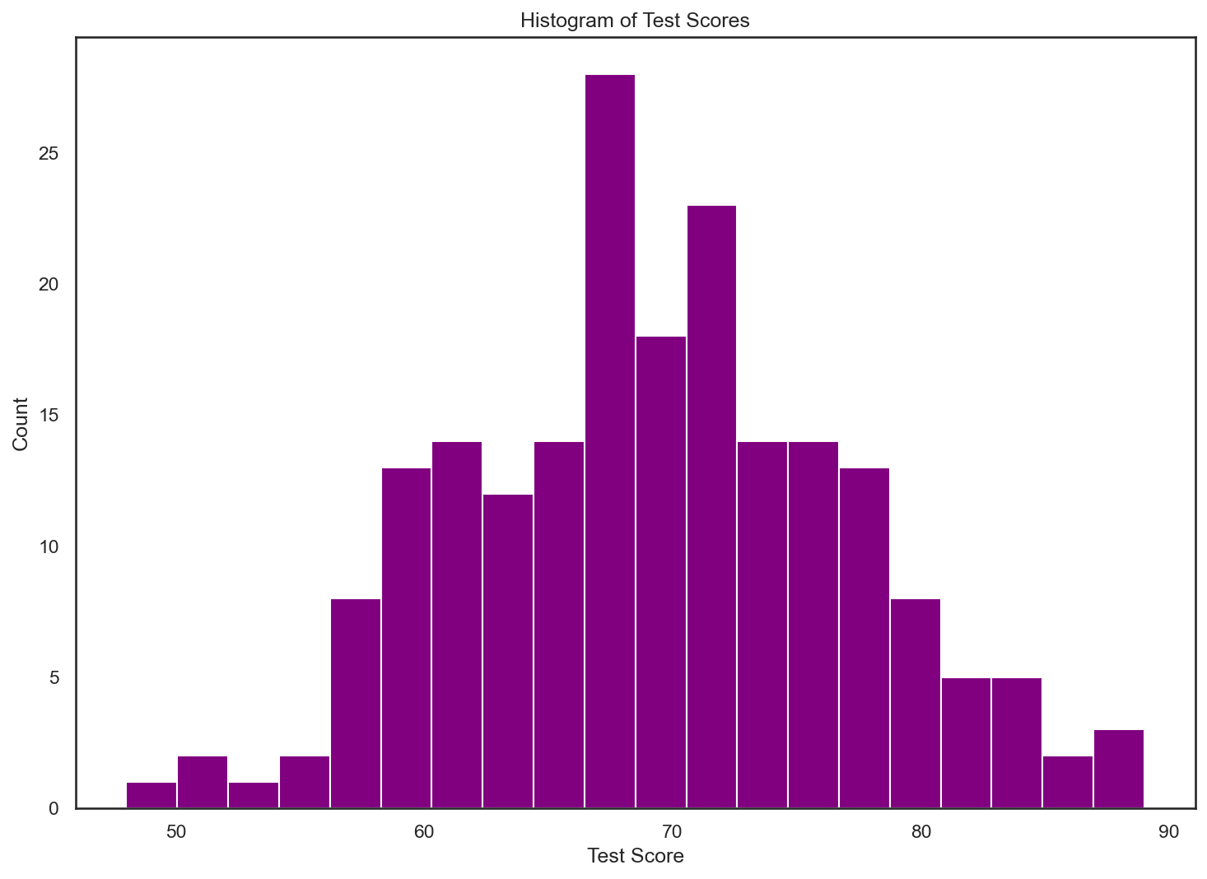
Normal Distribution
We now need to test if this data is normally distributed. There are few ways to do this, a simple way is to just visualize the data.
Student ID | Test Score
1 | 70
2 | 85
… | …
99 | 30
100 | 94
X

Slide 33
Normal Distribution
Here we can see the data appears visually to follow a normal distribution in the histogram.
Student ID | Test Score
1 | 70
2 | 85
… | …
99 | 30
100 | 94
X

Slide 34
Normal Distribution
But sometimes it may not be as clear, in that case, we have more stringent mathematical tests for normality.
Student ID | Test Score
1 | 70
2 | 85
… | …
99 | 30
100 | 94
X

Slide 35
Normal Distribution
There are several normality tests:
Kolmogorov–Smirnov test
Shapiro–Wilk test
Jarque–Bera test
Anderson–Darling test
And many more!
en.wikipedia.org/wiki/Normality_test
X

Slide 36
Normal Distribution
There are several normality tests:
Kolmogorov–Smirnov test
Shapiro–Wilk test
Jarque–Bera test
Anderson–Darling test
Note that these tests technically report back a probability of being normally distributed!
X

Slide 37
Normal Distribution
More specifically, these tests typically operate using a hypothesis paradigm, where you posit a hypothesis that your particular data sample (data of student test scores) is normally distributed or comes from a normally distributed population.
X

Slide 38
Normal Distribution
It’s recommended that you perform both a basic visual test and a normality test before assuming you can treat a dataset as normally distributed.
Let’s head back to our “real world” example of student tests.
X

Slide 39
Normal Distribution
After conducting a Shapiro-Wilk test, we will assume that the data is normally distributed.
Student ID | Test Score
1 | 70
2 | 85
… | …
99 | 30
100 | 94
X

Slide 40
Normal Distribution
Now that we can treat this data as normally distributed, we can use its mean and standard deviation to answer questions.
Student ID | Test Score
1 | 70
2 | 85
… | …
99 | 30
100 | 94
X

Slide 41
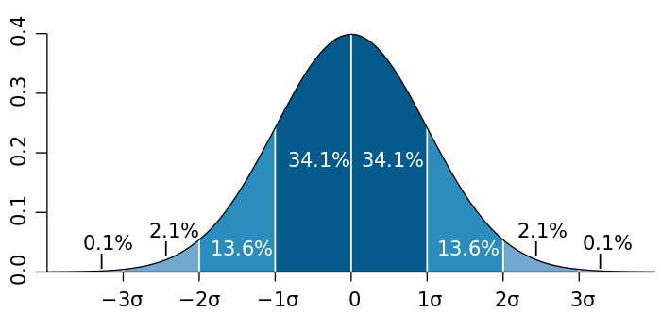
Normal Distribution
Normal Distributions come with unique properties of the mean and standard deviation.
X

Slide 42
Normal Distribution
Since we can calculate the mean and standard deviation from our data set, we can now begin to plug in formulas to answer questions.
X

Slide 43
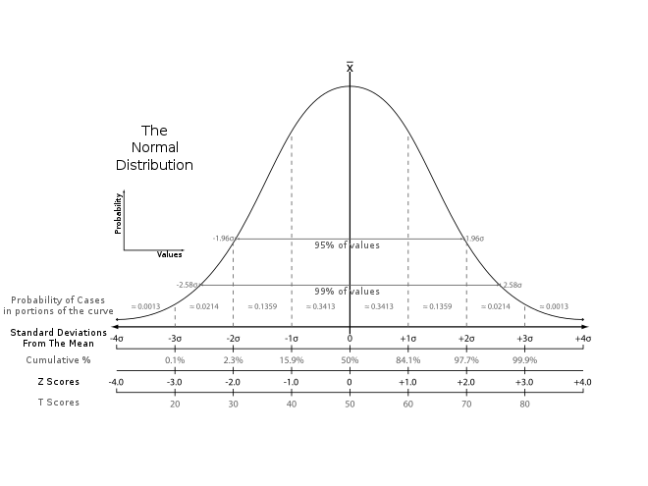

Normal Distribution
These calculations are so common, that a standard score or Z-Score system allows us to easily convert the probability space of the normal distribution using our data set values.
X

Slide 44
Normal Distribution
The absolute value of z represents the distance between that raw score x and the population mean in units of the standard deviation.
X

Slide 45
Normal Distribution
Z is negative when the raw score is below the mean, positive when above.
X

Slide 46
Normal Distribution
We’ll discuss Z-Scores in more detail later on in this section of the course. Technically we use the sample statistics and not the population statistics in this example.
X

Slide 47
Normal Distribution
Let’s revisit our data. Imagine we wanted to know the probability of a student scoring above an 80 on the test.
Student ID | Test Score
1 | 70
2 | 85
… | …
99 | 30
100 | 94
X

Slide 48
Normal Distribution
Notice how this differs from the question “How many students in our data set scored 80 or above on the test?”
Student ID | Test Score
1 | 70
2 | 85
… | …
99 | 30
100 | 94
X

Slide 49
Normal Distribution
The purpose of this exercise is to use our student sample to gain insight on the overall population of students.
Student ID | Test Score
1 | 70
2 | 85
… | …
99 | 30
100 | 94
X

Slide 50
Normal Distribution
In our example we have a mean of 69.32 and a standard deviation of 7.59.
Student ID | Test Score
1 | 70
2 | 85
… | …
99 | 30
100 | 94
X

Slide 51
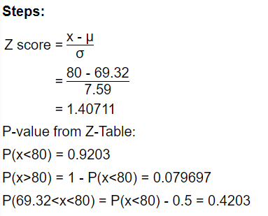
Normal Distribution
The Z-score formula for x=80, mean of 69.32 and standard deviation of 7.59 leads us to a Z-score of 1.407.
X

Slide 52
Normal Distribution
This means the probability of a student scoring above an 80 on the test is estimated to be 0.079 or approximately 8%.
X

Slide 53
Normal Distribution
Just as in our previous discussions of data distributions, once you’ve confirmed or recognized a normal distribution in your data, you can use the Z-Score relationships to easily answer probability questions about intervals in your sample data.
X

Slide 54
Normal Distribution
The reason why the normal distribution is so critical to understand, is because so many data sets in nature happen to be normally distributed.
Part of the reason behind that has to do with the central limit theorem, which we’ll discuss later on in the course!
X

Slide 55
Normal Distribution
For now, let’s take a closer look at the normal distribution and its unique properties!
X

